Slide 1
models of epidemics on contact networks

Slide 2
Diffusion Versus Epidemics
Diffusion in networks: The spread of ideas, innovations, behaviors in networks.
Epidemics in networks: The spread of diseases over networks of contact between individuals.
Main difference. How does one person “infect” another? In the case of ideas and innovations, people are making decisions whether or not to adopt a new idea or innovation. In the case of diseases, the disease transmission is not a decision-making process.

Slide 3
What Kind of Models?
Simplified models of the spread of disease over networks of contact between humans, animals, plants, etc. More focus on how diseases spread on underlying network of contacts than on biological or medical aspects of the diseases.
We’ll consider the following classic models of epidemics on networks:
the SI model;
the SIR model;
the SIS model.
What do the letters S, I, R stand for?

Slide 4
Susceptible
A node is in the susceptible state if it does not have the disease yet but could catch it from its neighbors.
Infected
A node is in the infected state if it has the disease and can, with some probability, pass it on to its susceptible neighbors.
Removed
A node is removed from consideration if, after an infectious period, it cannot infect other nodes and cannot be infected by other nodes.

Slide 5
There two completely opposite reasons to remove a node from consideration:
the node has recovered and got immunity to the disease;
the node has died.
Removed
A node is removed from consideration if, after an infectious period, it cannot infect other nodes and cannot be infected by other nodes.

Slide 6
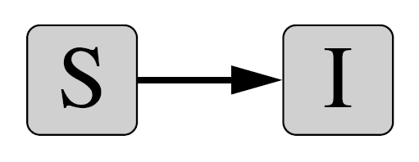
The SI Model

Slide 7
Assumptions for SI
The SI model is the simplest model based on the following assumptions (not too realistic):
S or I. At any time instance, each node is either susceptible or infected.
Contacts. Every node has an equal chance, per unit time (for example, per day), of coming into contact with every other.
Disease transmission. At any time instance, the probability of disease transmission from an infected node to a susceptible node is constant.

Slide 8

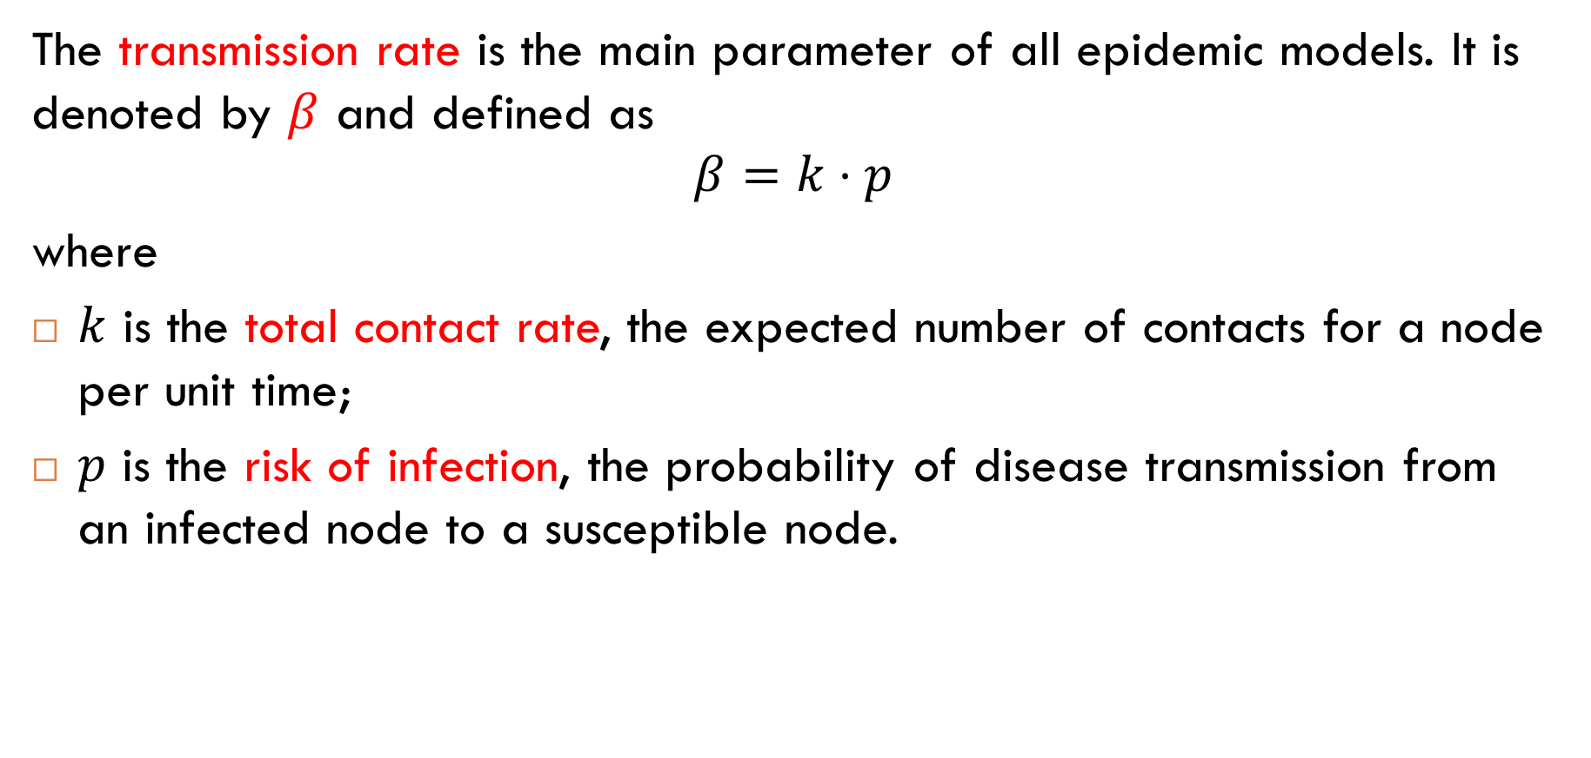
Transmission Rate
The transmission rate is the main parameter of all epidemic models. It is denoted by $β$ and defined as
$$β=k⋅p$$
where
$k$ is the total contact rate, the expected number of contacts for a node per unit time;
$p$ is the risk of infection, the probability of disease transmission from an infected node to a susceptible node.
We can think of $β$ as the average number of infection-producing contacts per node per unit time.

Slide 9
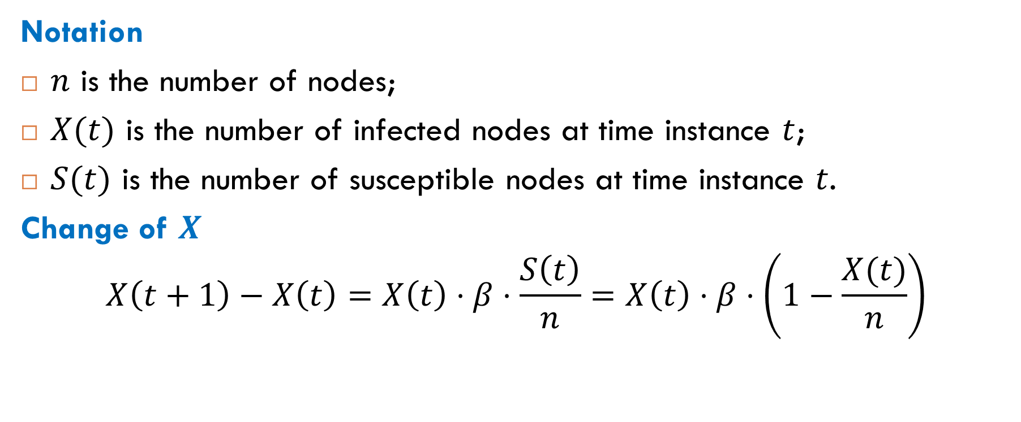
Number of Infected Nodes
Notation
$n$ is the number of nodes;
$X(t)$ is the number of infected nodes at time instance $t$;
$S(t)$ is the number of susceptible nodes at time instance $t$.
Change of $X$
$$X\left(t+1\right)−X\left(t\right)=X\left(t\right)⋅β⋅\frac{S\left(t\right)}{n}=X\left(t\right)⋅β⋅\left(1−\frac{X(t)}{n}\right)$$
probability that a random contact is a contact with a susceptible node

Slide 10
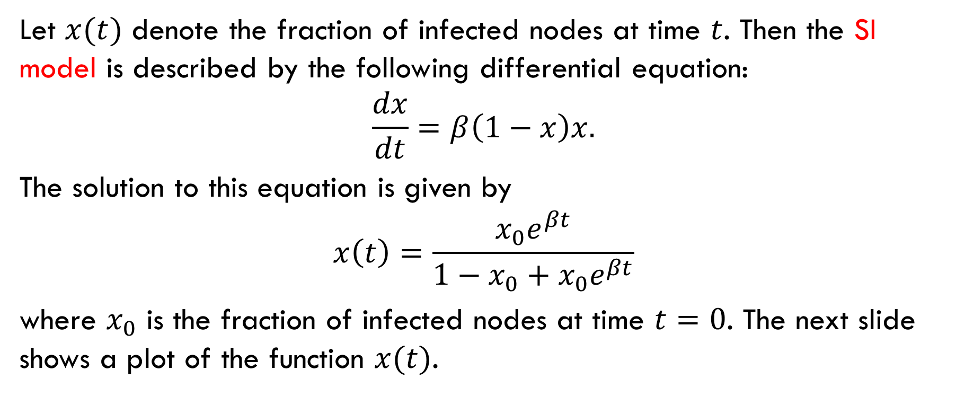
Fraction of Infected Nodes
Let $x(t)$ denote the fraction of infected nodes at time $t$. Then the SI model is described by the following differential equation:
$$\frac{dx}{dt}=β\left(1−x\right)x.$$
The solution to this equation is given by
$$x\left(t\right)=\frac{x_{0}e^{βt}}{1−x_{0}+x_{0}e^{βt}}$$
where $x_{0}$ is the fraction of infected nodes at time $t=0$. The next slide shows a plot of the function $x(t)$.

Slide 11
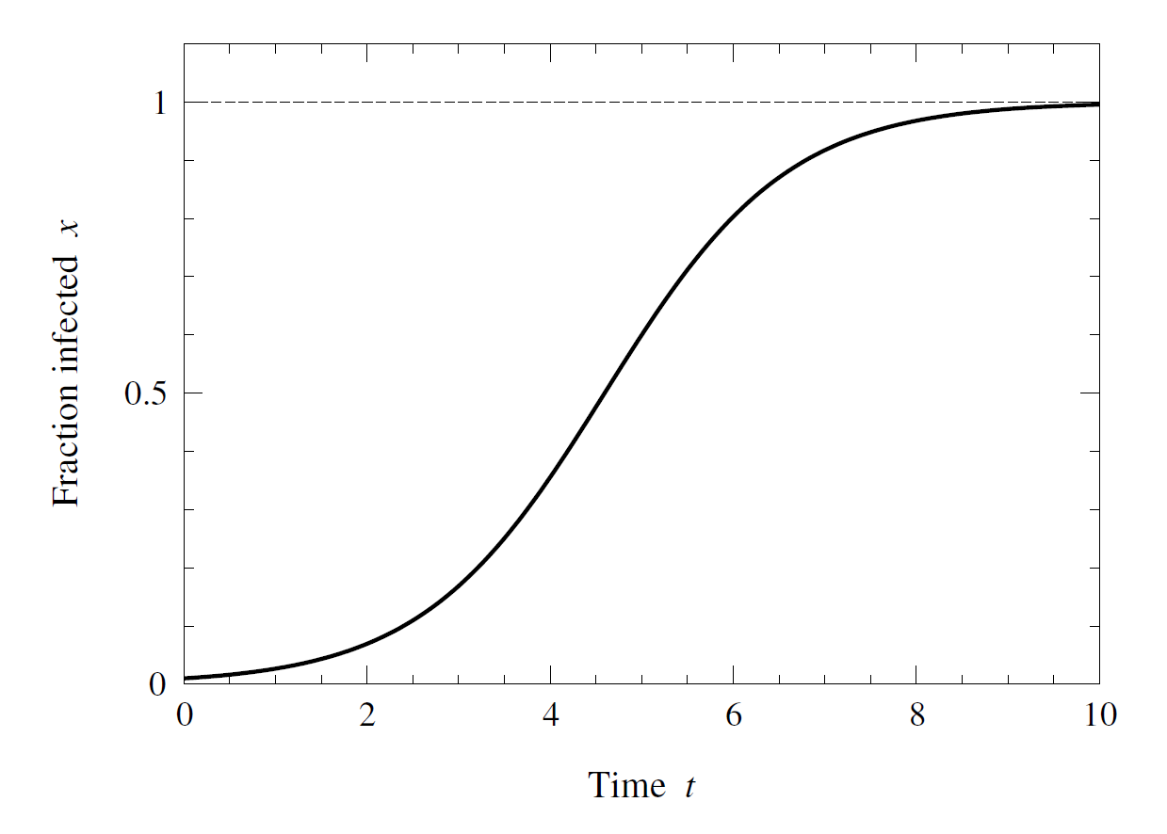
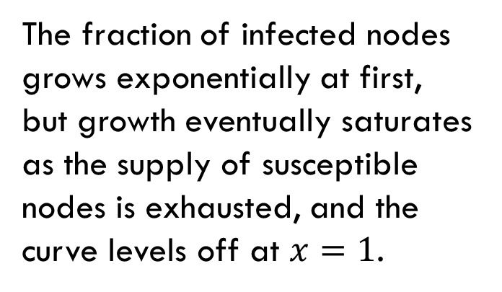



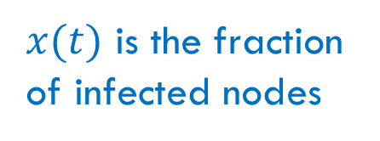
Plot of $x(t)$
$x(t)$ is the fraction of infected nodes
$x_{0}=x\left(0\right)=0.01$
The fraction of infected nodes grows exponentially at first, but growth eventually saturates as the supply of susceptible nodes is exhausted, and the curve levels off at $x=1$.
$$x(t)$$

Slide 12
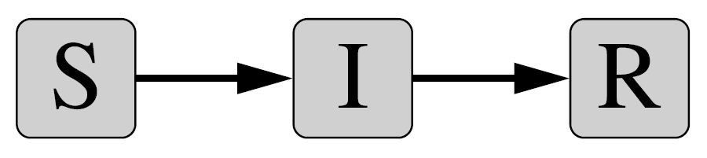
The SIR Model

Slide 13
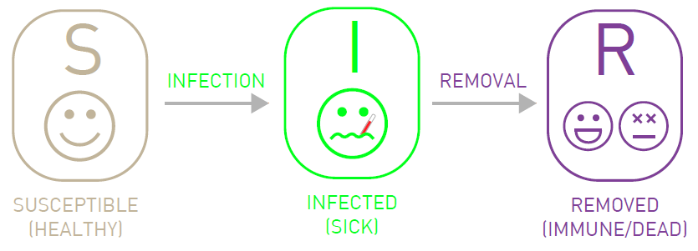
The SIR model is a more realistic modification of the SI model.

Slide 14
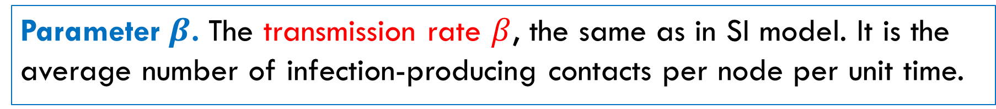

Two Parameters of the SIR Model
Parameter $β$. The transmission rate $β$, the same as in SI model. It is the average number of infection-producing contacts per node per unit time.
Parameter $γ$. Another parameter is the removal rate $γ$. It is defined to be the fraction of infected nodes removed per unit time.
Equivalently, 𝛾 is the probability that an infected node is removed during unit time.
Also note that 1/𝛾 is the expected length of the infection period, from entering the infection state to entering the removal state.

Slide 15
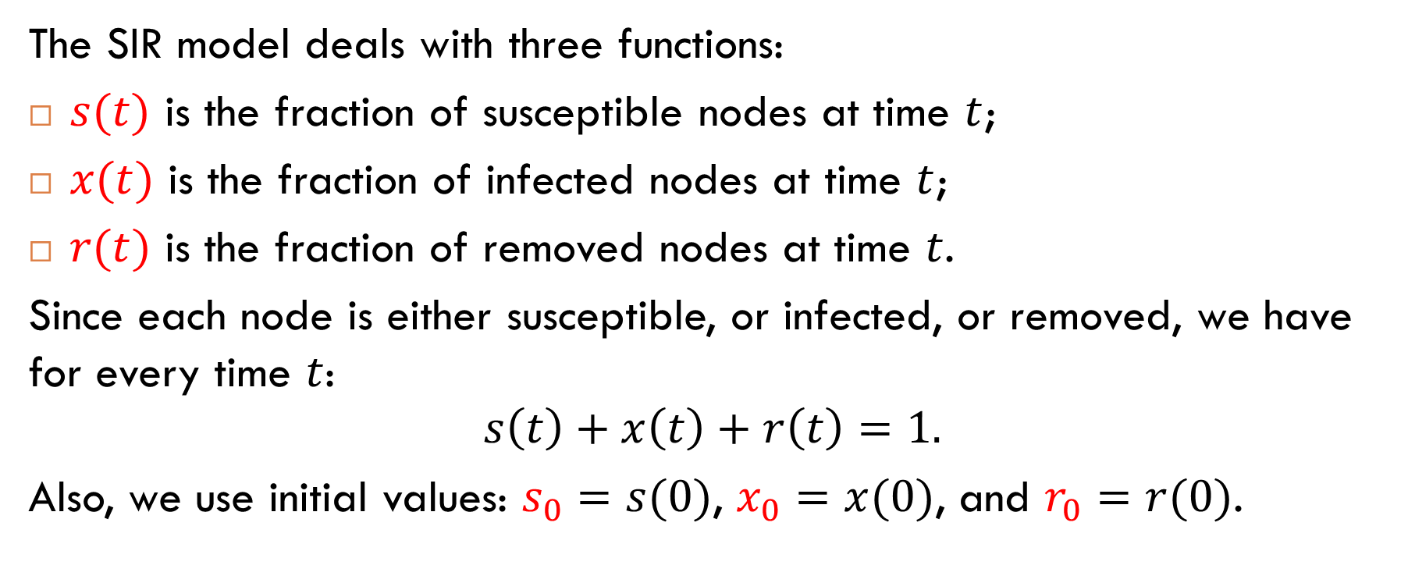
Three Fractions
The SIR model deals with three functions:
$s(t)$ is the fraction of susceptible nodes at time $t$;
$x(t)$ is the fraction of infected nodes at time $t$;
$r(t)$ is the fraction of removed nodes at time $t$.
Since each node is either susceptible, or infected, or removed, we have for every time $t$:
$$s\left(t\right)+x\left(t\right)+r\left(t\right)=1.$$
Also, we use initial values: $s_{0}=s(0)$, $x_{0}=x(0)$, and $r_{0}=r(0)$.

Slide 16




Equations for $s(t)$, $x(t)$, and $r(t)$
The three fractions are described by the following differential equations:
$$\frac{ds}{dt}=−βsx$$
These equations have no closed-form solutions, but they can be solved numerically. The next slide shows an example of such numerical solutions.
$$\frac{dx}{dt}=βsx−γx$$
$$\frac{dr}{dt}=γx$$

Slide 17
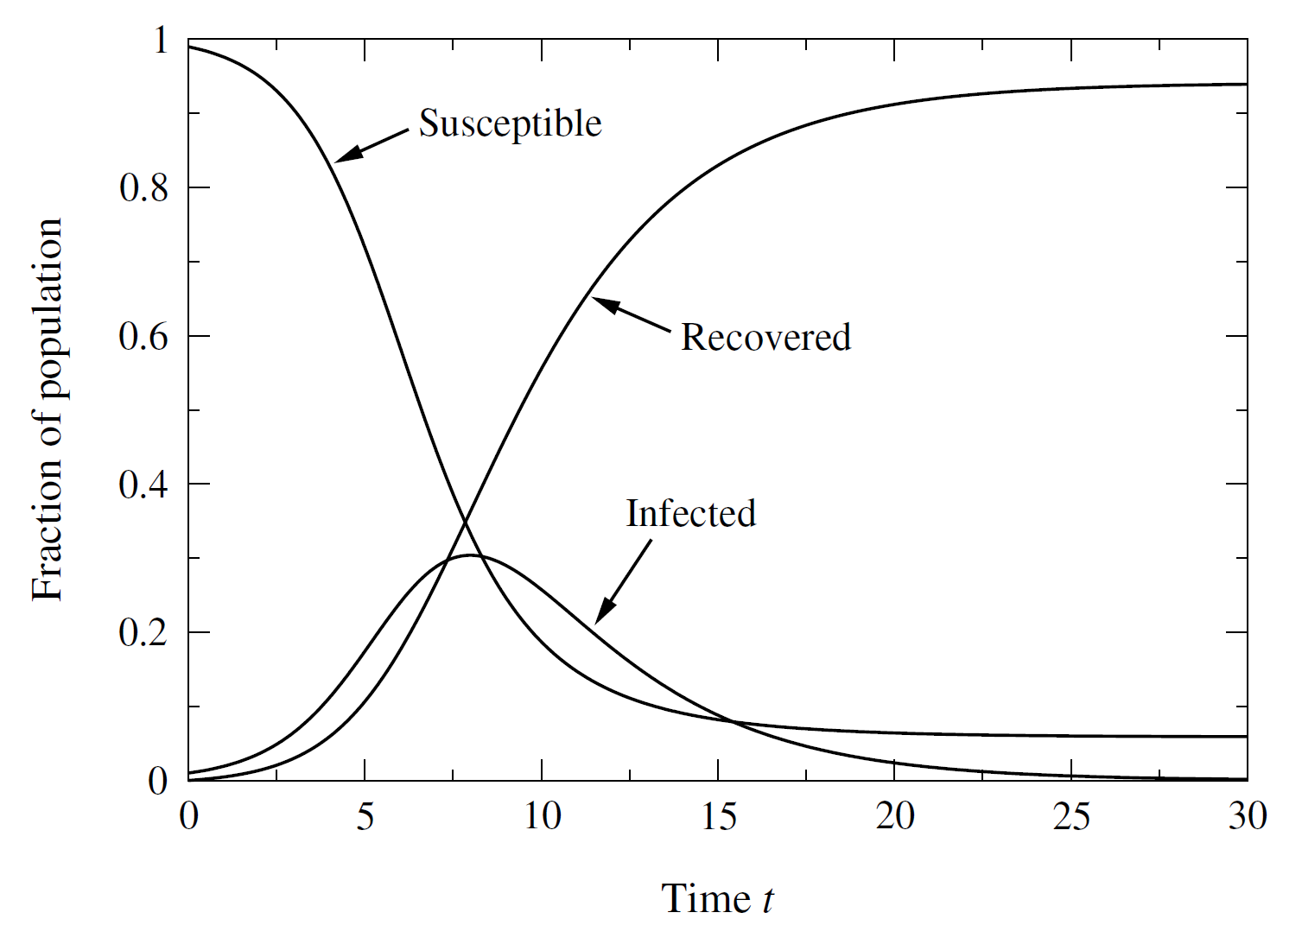
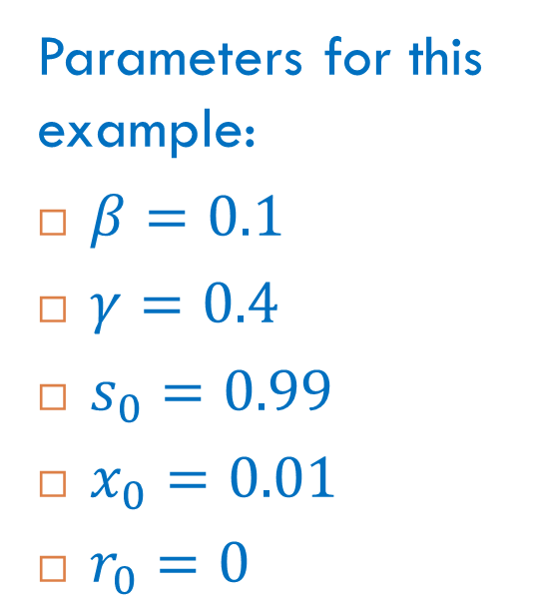
Example of Numerical Solutions
Parameters for this example:
$β=0.1$
$γ=0.4$
$s_{0}=0.99$
$x_{0}=0.01$
$r_{0}=0$

Slide 18
Comments
The fraction of susceptible nodes decreases monotonically (but it does not go to zero).
The fraction of infected nodes goes up as nodes get infected, then down as they are removed, and eventually goes to zero.
The fraction of removed nodes increases monotonically.

Slide 19
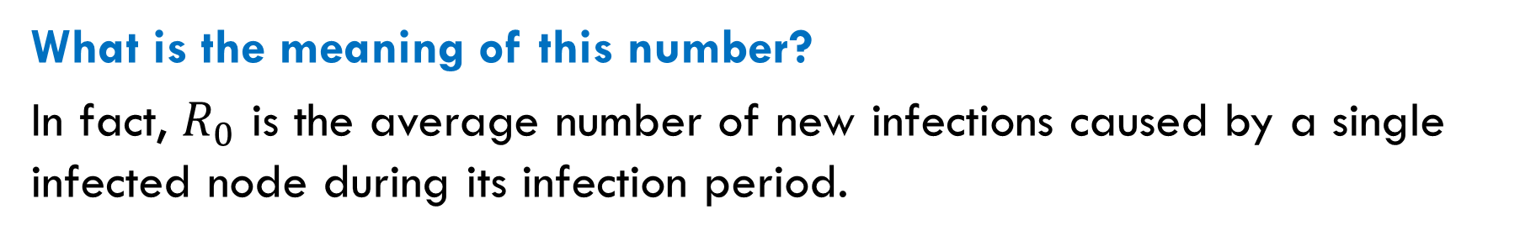
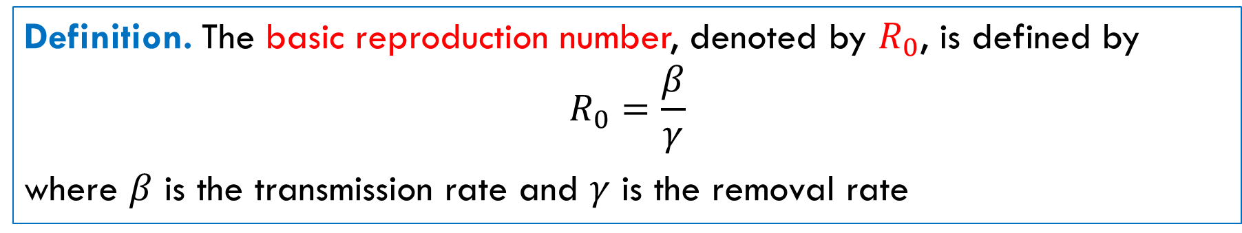
Basic Reproduction Number
Definition. The basic reproduction number, denoted by $R_{0}$, is defined by
$$R_{0}=\frac{β}{γ}$$
where $β$ is the transmission rate and $γ$ is the removal rate
What is the meaning of this number?
In fact, $R_{0}$ is the average number of new infections caused by a single infected node during its infection period.

Slide 20
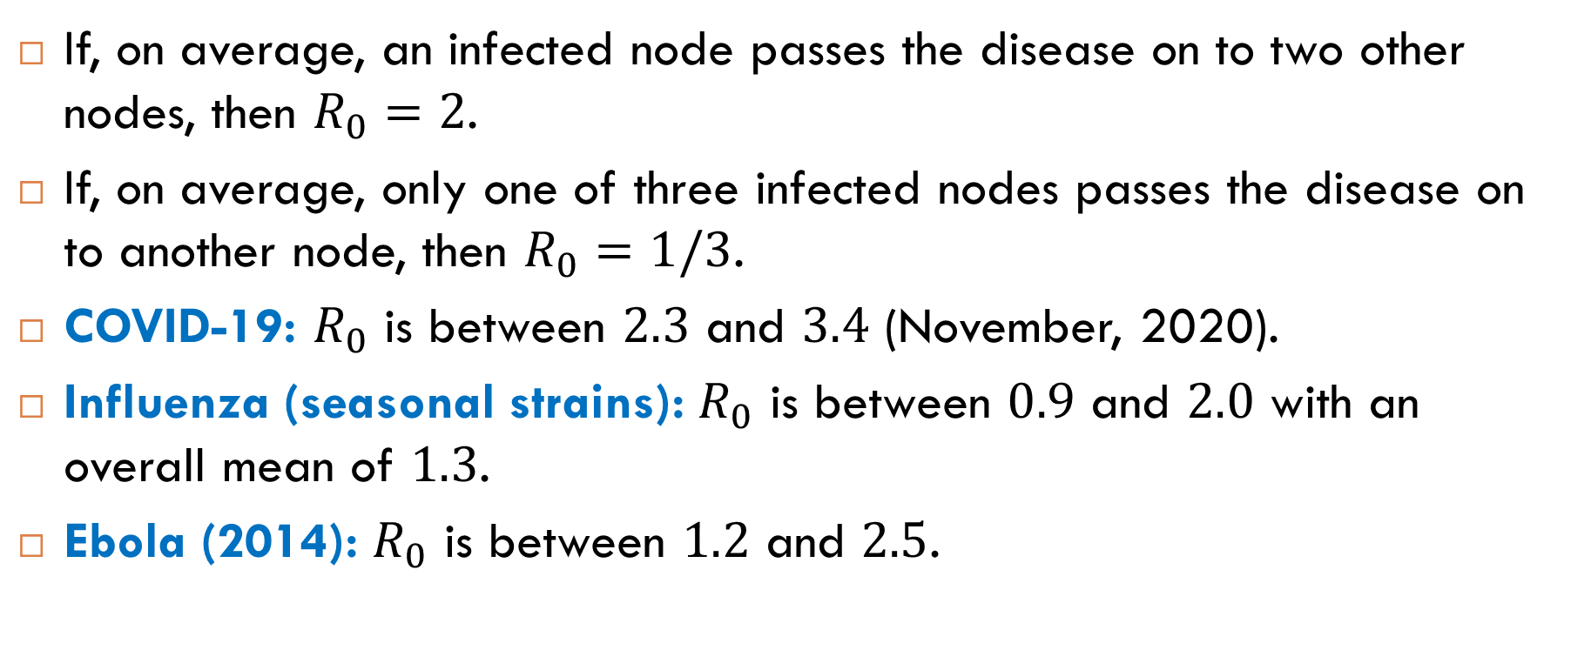
Examples
If, on average, an infected node passes the disease on to two other nodes, then $R_{0}=2$.
If, on average, only one of three infected nodes passes the disease on to another node, then $R_{0}=1/3$.
COVID-19: $R_{0}$ is between $2.3$ and $3.4$ (November, 2020).
Influenza (seasonal strains): $R_{0}$ is between $0.9$ and $2.0$ with an overall mean of $1.3$.
Ebola (2014): $R_{0}$ is between $1.2$ and $2.5$.

Slide 21
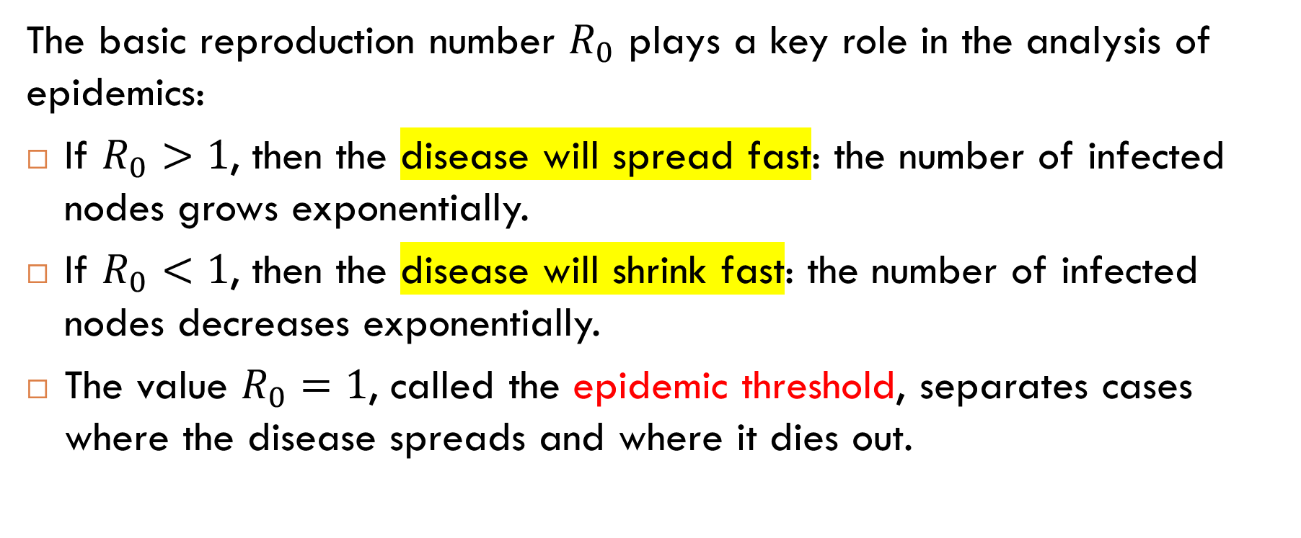
Epidemic Threshold
The basic reproduction number $R_{0}$ plays a key role in the analysis of epidemics:
If $R_{0}>1$, then the disease will spread fast: the number of infected nodes grows exponentially.
If $R_{0}<1$, then the disease will shrink fast: the number of infected nodes decreases exponentially.
The value $R_{0}=1$, called the epidemic threshold, separates cases where the disease spreads and where it dies out.

Slide 22
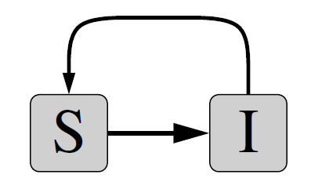
The SIS Model

Slide 23
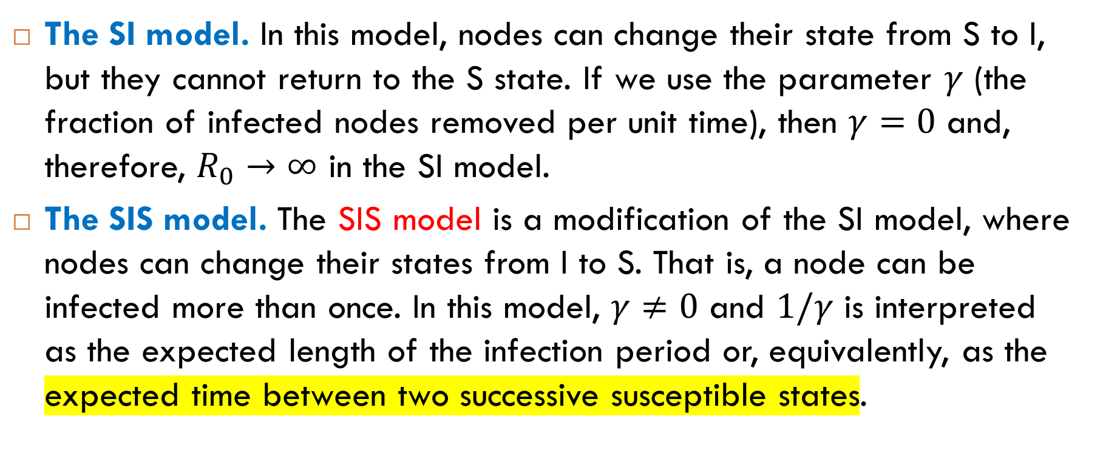
Another Modification of the SI Model
The SI model. In this model, nodes can change their state from S to I, but they cannot return to the S state. If we use the parameter $γ$ (the fraction of infected nodes removed per unit time), then $γ=0$ and, therefore, $R_{0}→∞$ in the SI model.
The SIS model. The SIS model is a modification of the SI model, where nodes can change their states from I to S. That is, a node can be infected more than once. In this model, $γ≠0$ and $1/γ$ is interpreted as the expected length of the infection period or, equivalently, as the expected time between two successive susceptible states.

Slide 24
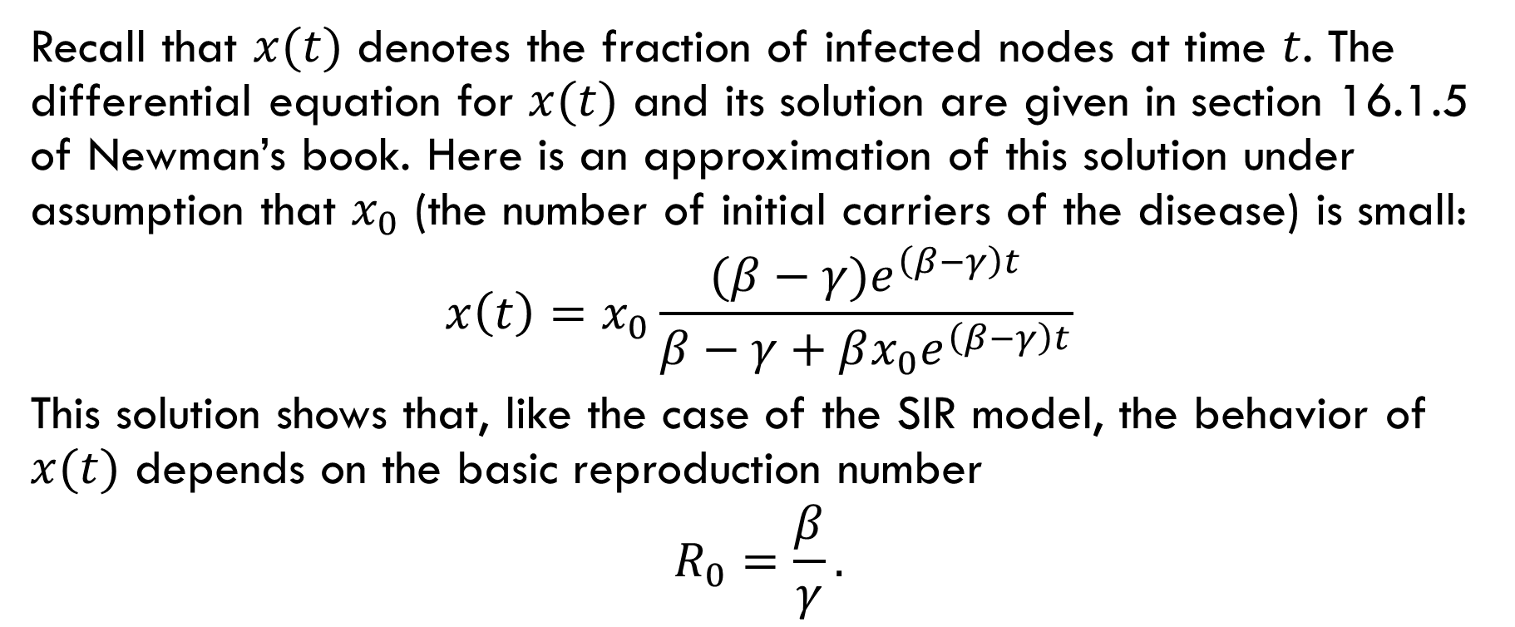
Analysis of the SIS Model
Recall that $x(t)$ denotes the fraction of infected nodes at time $t$. The differential equation for $x(t)$ and its solution are given in section 16.1.5 of Newman’s book. Here is an approximation of this solution under assumption that $x_{0}$ (the number of initial carriers of the disease) is small:
$$x\left(t\right)=x_{0}\frac{(β−γ)e^{\left(β−γ\right)t}}{β−γ+βx_{0}e^{\left(β−γ\right)t}}$$
This solution shows that, like the case of the SIR model, the behavior of $x(t)$ depends on the basic reproduction number
$$R_{0}=\frac{β}{γ}.$$

Slide 25
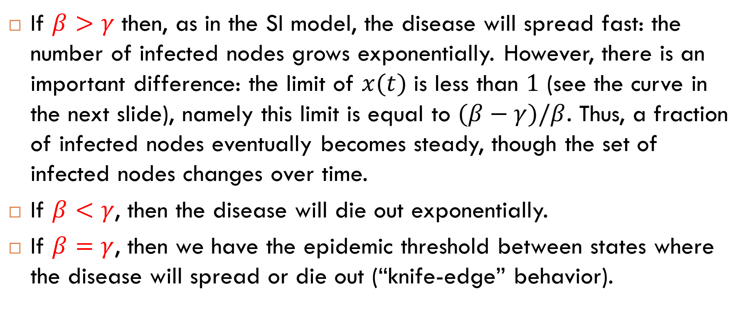
Analysis of the SIS Model (cont.)
If $β>γ$ then, as in the SI model, the disease will spread fast: the number of infected nodes grows exponentially. However, there is an important difference: the limit of $x(t)$ is less than $1$ (see the curve in the next slide), namely this limit is equal to $(β−γ)/β$. Thus, a fraction of infected nodes eventually becomes steady, though the set of infected nodes changes over time.
If $β<γ$, then the disease will die out exponentially.
If $β=γ$, then we have the epidemic threshold between states where the disease will spread or die out (“knife-edge” behavior).

Slide 26
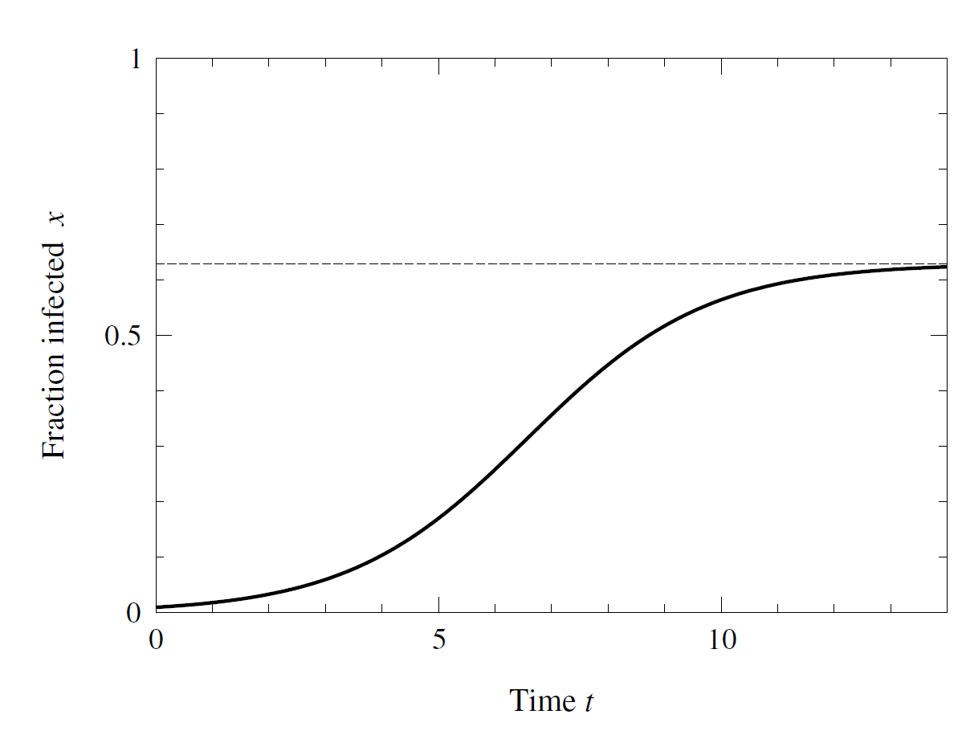
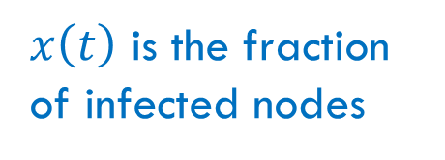

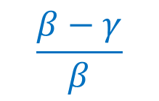
Numerical Solution
$$\frac{β−γ}{β}$$
$x\left(t\right)$ is the fraction of infected nodes
$$x(t)$$

Slide 27
Epidemic Models on Real-World Networks

Slide 28
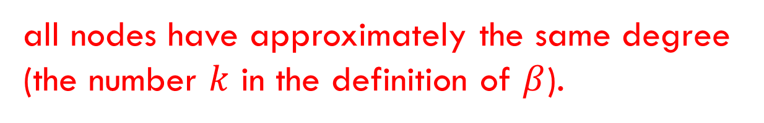
Contact Networks
Assumption
Our models were based on the following assumption about the underlying contact network:
all nodes have approximately the same degree (the number $k$ in the definition of $β$).
Question
Is this assumption realistic for real-world contact networks?

Slide 29
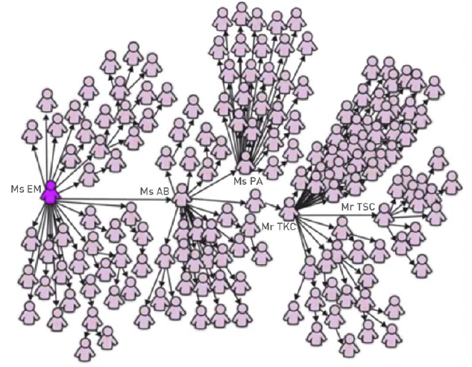
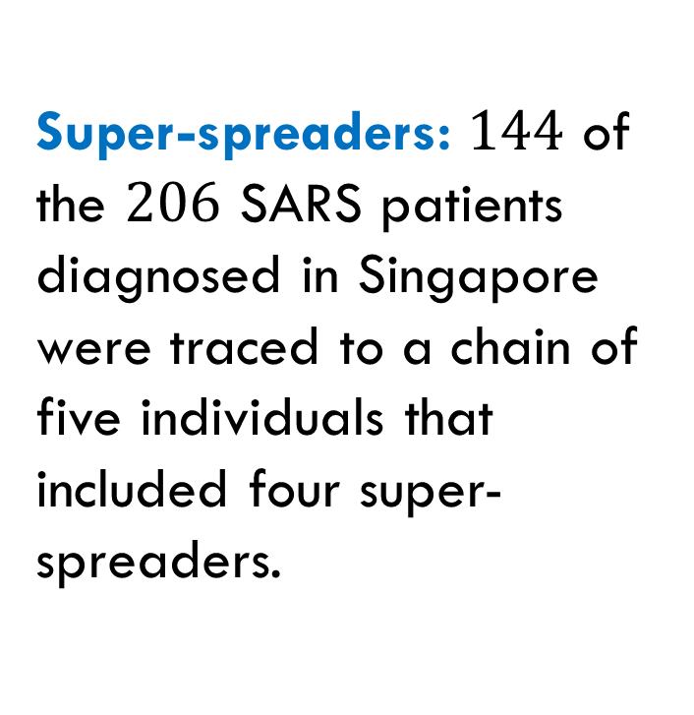
Super-Spreaders
Super-spreaders: $144$ of the $206$ SARS patients diagnosed in Singapore were traced to a chain of five individuals that included four super-spreaders.

Slide 30
General Results for the SIR and SIS Models
Consider a contact network with hubs (for example, a scale-free network) and a contact network where all degrees are close to the average (for example, a random network).
Consider a disease with the same parameters.
Question
Where the disease spreads faster?
Answer
On contact networks with hubs.

Slide 31
Exercise

Slide 32
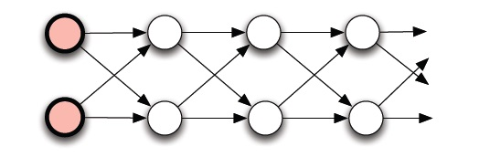

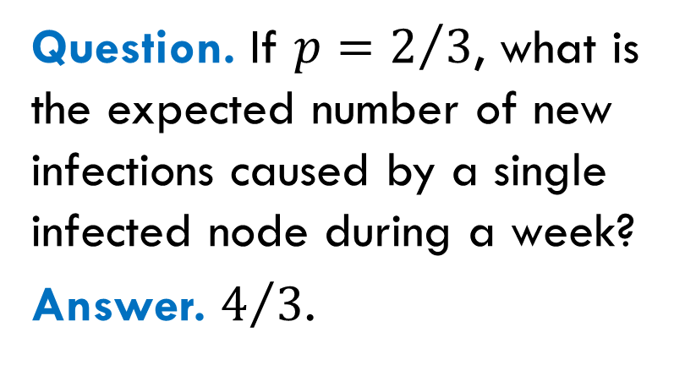
Example
Suppose that the infection period is a week (an infected node is removed in a week after entering the infected state).
Let $p$ be the probability that an infected node transmits the disease along a directed edge during a week.
Question. If $p=2/3$, what is the expected number of new infections caused by a single infected node during a week?
Answer. $4/3$.

Slide 33
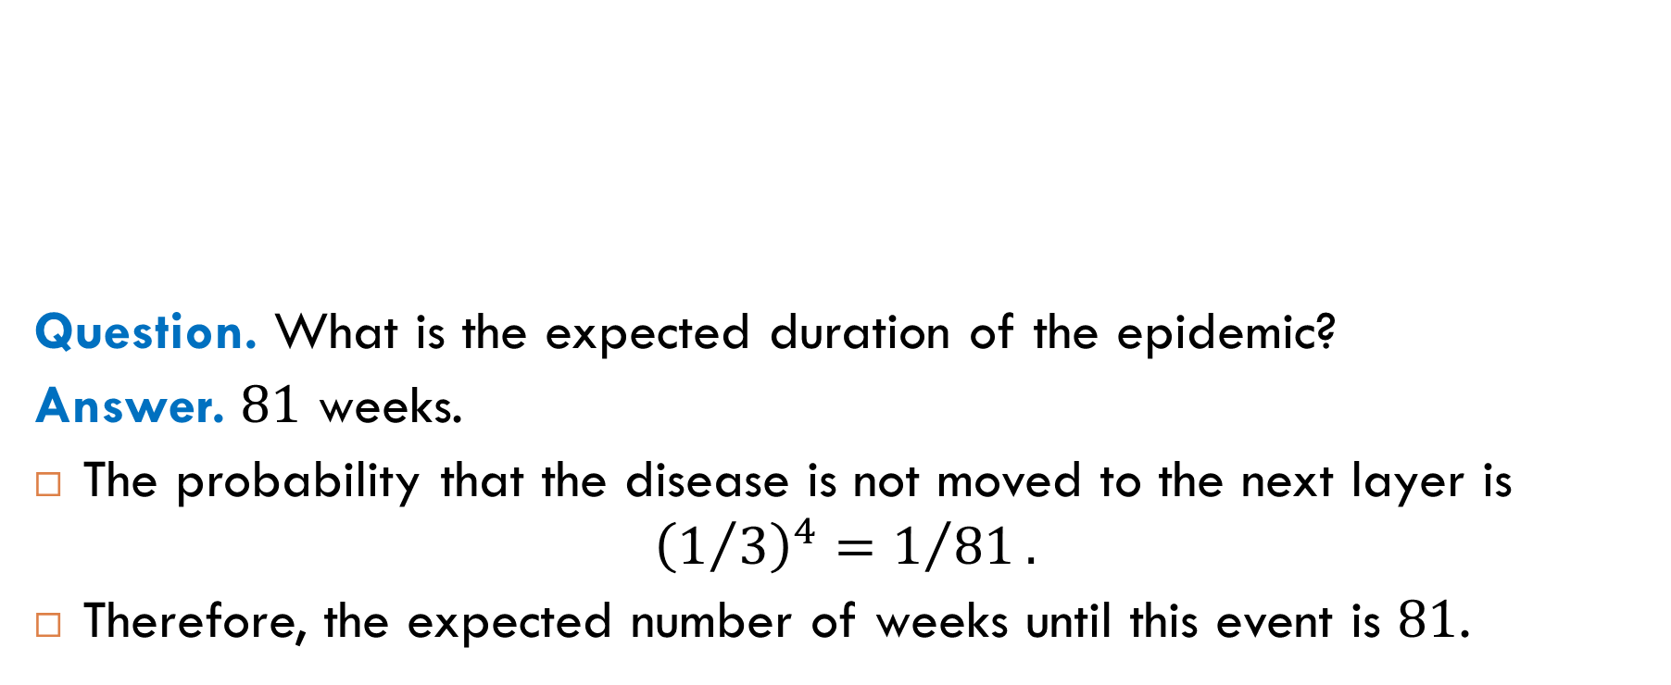
Duration of the Epidemic
Question. What is the expected duration of the epidemic?
Answer. $81$ weeks.
The probability that the disease is not moved to the next layer is
$${\left(1/3\right)}^{4}=1/{81}.$$
Therefore, the expected number of weeks until this event is $81$.

Slide 34

Reading
Sections 16.1-16.2

